Slide 1
Using Python Interpreter

Slide 2
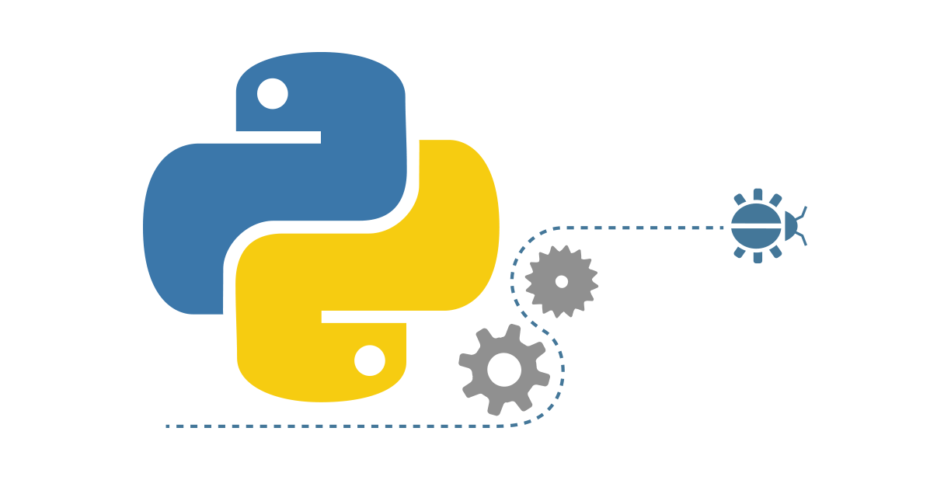
Agenda
Interpreter
Invoking the interpreter
Argument Passing
Source Code Encoding

Slide 3

Interpreter
An interpreter is a program that reads and executes code. This includes source code, pre-compiled code, and scripts.
Common interpreters include Perl, Python, and Ruby interpreters.

Slide 4
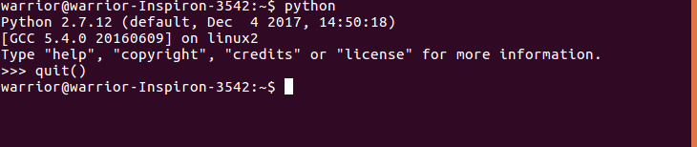
Invoking the Python interpreter
Start python interpreter by typing the command python in the shell.
Notes:
This is assuming that the PC already has python installed in it.

Slide 5
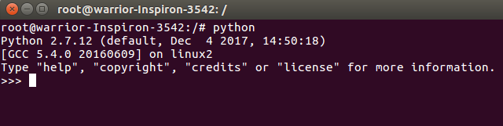
Interactive Mode
The interpreter prints a welcome message stating its version number and a copyright notice before printing the first prompt.
The interactive mode prompts for the next command with the primary prompt, usually three greater-than signs (>>>).
For continuation lines it prompts with the secondary prompt, by default three dots (...).

Slide 6
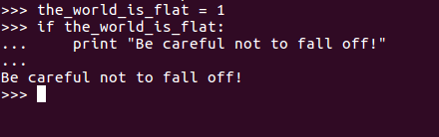
Interactive Mode
Continuation lines are needed when entering a multi-line construct. As an example, take a look at this if statement:

Slide 7
Exiting the Interpreter
When you want to exit the interpreter, typing an end-of-file character (Control + D on Unix, Control + Z on Windows) causes the interpreter to exit with a zero exit status.
If that doesn’t work, you can exit the interpreter by typing the following command: quit().

Slide 8
Run a file
Let’s say that there’s a file called sample.py in your PC that prints “Hello World”.
It can be executed at the command line by invoking the interpreter as: python sample.py
Contents in script file are: print “Hello World”
Notes:
Note − Be sure the file permission mode allows execution.

Slide 9
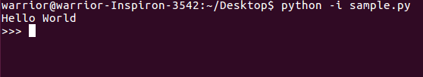
Python Interpreter
When a script file is used, it is sometimes useful to be able to run the script and enter interactive mode afterwards.
This can be done by passing -i before the script.
Example: python -i sample.py

Slide 10
END

